Slide 1

Serverless Real-time Analytics Dashboard with AWS Kinesis Analytics
N.Tulasi (2210030388)
Under the esteemed guidance of
Ms. P. Sree Lakshmi
Assistant Professor,
Department of Computer Science and Engineering

Slide 2
Project Overview
Problem : Design a serverless real-time analytics dashboard using AWS services to efficiently process, store, and visualize streaming data with minimal operational overhead.
Objective : To build a serverless real-time analytics dashboard using AWS.
Relevance: Enables organizations to gain instant insights from streaming data, supporting timely decisions in domains like e-commerce, IoT, and finance.

Slide 3
Services Used
Amazon Kinesis for real-time data streaming.
Firehose for delivery the data stream to S3.
S3 for storage.
EC2 to simulate data streams.
CloudWatch to monitor the data stream on Dashboard.

Slide 4
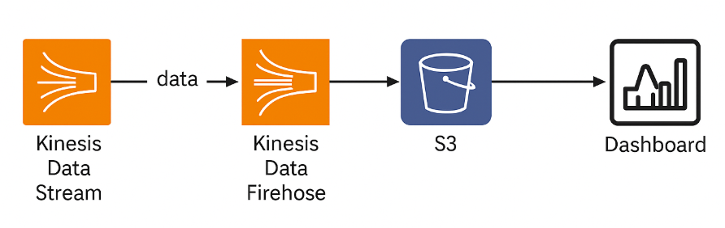
Flow Diagram

Slide 5
Implementation Process
Generate Real-time Temperature Data: Use EC2 to generate real-time temperature data.
Set up AWS Kinesis Data Streams: Create a Kinesis data stream to ingest the temperature data from EC2.
Set up AWS Kinesis Firehose: Configure Kinesis Firehose to consume data from the Kinesis Data Stream and send it to S3 for storage.
Store Data in S3: Firehose will deliver the temperature data to an S3 bucket for further analysis.
Set up CloudWatch Dashboards: Use AWS CloudWatch to create real-time dashboards for monitoring and visualizing the temperature data.

Slide 6
Key Features and Functionality
Data Generation: EC2 streams temperature data.
Data Ingestion: Kinesis Data Streams.
Data Delivery: Kinesis Firehose to S3.
Real-Time Monitoring: CloudWatch dashboards.
End-User View : CloudWatch Dashboards: Real-time temperature data with updates and alerts.

Slide 7
Results
Real-time Data Ingestion: Temperature data is continuously streamed from EC2 to Kinesis Data Streams.
Data Delivery: Kinesis Firehose delivers the data to S3 in near real-time.
Data Visualization: CloudWatch dashboards display real-time visualizations of the temperature data.
Scalable Solution: The architecture automatically scales to handle the incoming data streams without manual intervention.

Slide 8
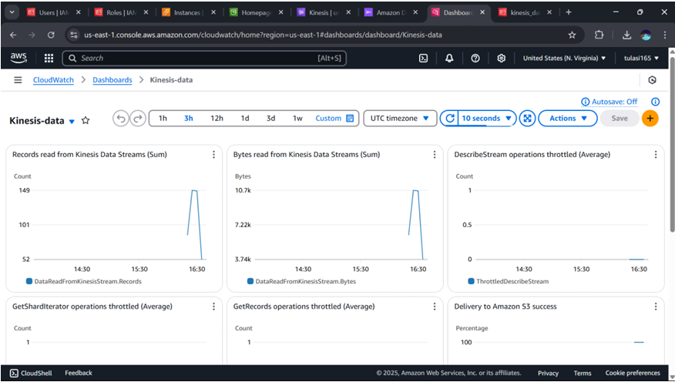
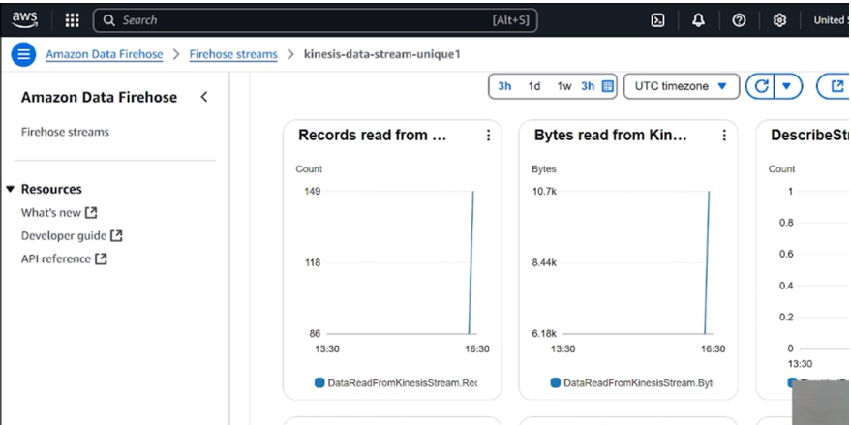
Outputs

Slide 9
Challenges and Solutions
Challenges:
Data Latency: Delay in streaming data from EC2 to Kinesis.
Real-Time Processing: Ensuring smooth, lag-free processing.
Service Integration: Configuring Kinesis, Firehose, and S3.
Resolutions:
Optimized Streams: Tuned Kinesis Data Streams for low latency.
Reliable Delivery: Used Firehose for seamless data transfer to S3.
Service Testing: Ensured correct service integration.

Slide 10
Learnings & Takeaways
Technical Skills Gained:
Kinesis Data Streams & Firehose: Gained hands-on experience in data streaming and delivery.
AWS EC2: Improved knowledge in real-time data generation and management.
AWS CloudWatch: Developed expertise in real-time monitoring and dashboard creation.
S3: Enhanced skills in data storage and management with AWS services.

Slide 11
Future Scope
Extensions/Improvements: Add machine learning for predictive analysis, enhance the dashboard UI, and integrate more IoT sensors.
Deployment Considerations: Ensure data reliability, optimize for low-latency streaming, and implement robust security with IAM.
Cost Optimization/Scaling: Use EC2 Auto Scaling, adjust Kinesis resources based on demand, and leverage S3 lifecycle policies for storage cost reduction.

Slide 12
References
[1] Amazon Personalize Customer Outreach on Your E-commerce Platform: https://aws.amazon.com/blogs/architecture/amazon-personalize-customer-outreach-on-yourecommerce platform/
[2] E-commerce Personalization with AWS: https://www.brilworks.com/blog/ecommerce-personalization with-aws/
[3] Research Paper on E-commerce Personalization (arXiv): https://arxiv.org/abs/2105.06508
[4] Real-time Analytics Use Cases and Examples: https://www.striim.com/blog/real-time-analytics-use cases-and-examples/#use
[5] AWS in Healthcare Industry: https://aws.amazon.com/blogs/industries/category/industries/healthcare/
[6] Detect Game Anomalies with Amazon Lookout for Metrics: https://aws.amazon.com/blogs/gametech/detect-game-anomalies-amazon-lookout-for-metricsgame-analytics pipeline/

Slide 13
THANK YOU

